Slide 1
BlazeMeter and Load Impact
ataichi.github.io - Tutorial by Tricia Nieva

Slide 2
Loading . .
Everything was perfect . .

Slide 3
BlazeMeter and Load Impact
Used for Load and Performance Tests
Identifies maximum capacity
Users
Data
Can create virtual users
Determine how long it takes to load
Min (best case)
Max (worst case)

Slide 4
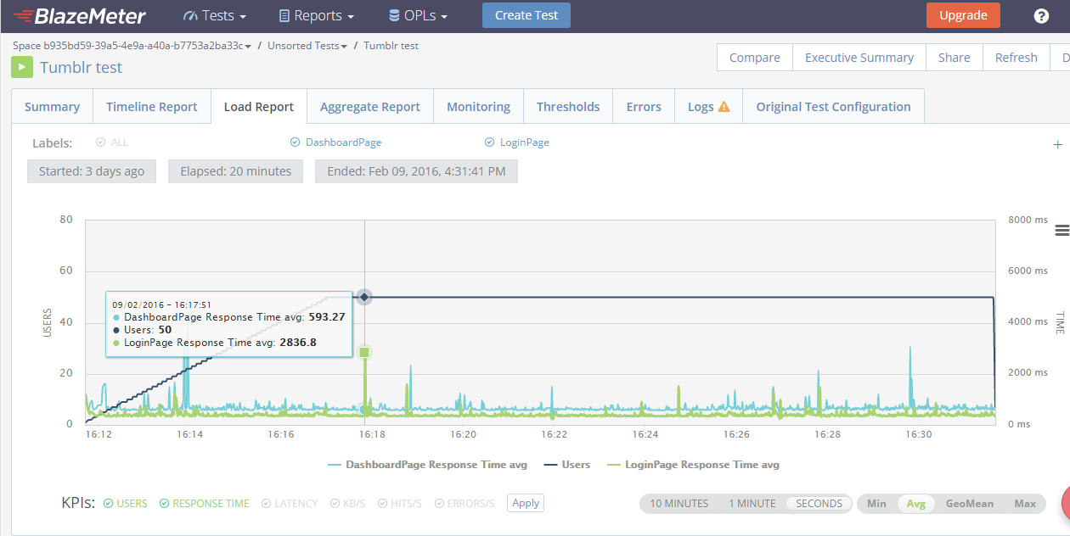

Slide 5
BlazeMeter VS Load Impact
Compatible with Apache JMeter (the top open source load testing app) | User can input customized data stores
Can see reports in real-time | See reports only when the test is finished
Test different URLs simultaneously | Can have 10 different locations of virtual users in a single test
Can see in seconds, minutes, min, max of response time | Can schedule tests
Can compare up to 5 different reports simultaneously | Have a report per test

Slide 6
Importance
Enrolment
Online Shopping
Bank Transactions
Individual
Entrepreneurs
Downloading Resources

Slide 7
Advantages of these Performance Test Tools
Self Service
Uses the Cloud (Start it now, open again later)
Automation of Tests
Less Physical Machines and Real Users
Presents the importance of Time and Baselines
Saves a Company from Losing Profit

